Slide 1
DCV582/584 Upgrade
from TYPE1 to TYPE2

Slide 3
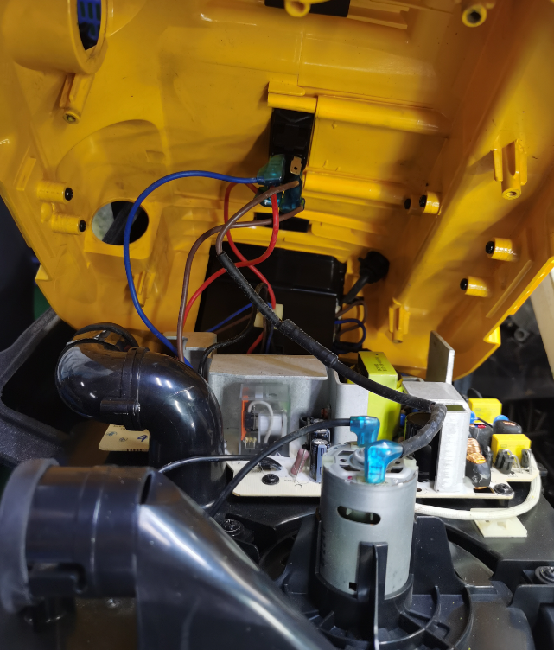
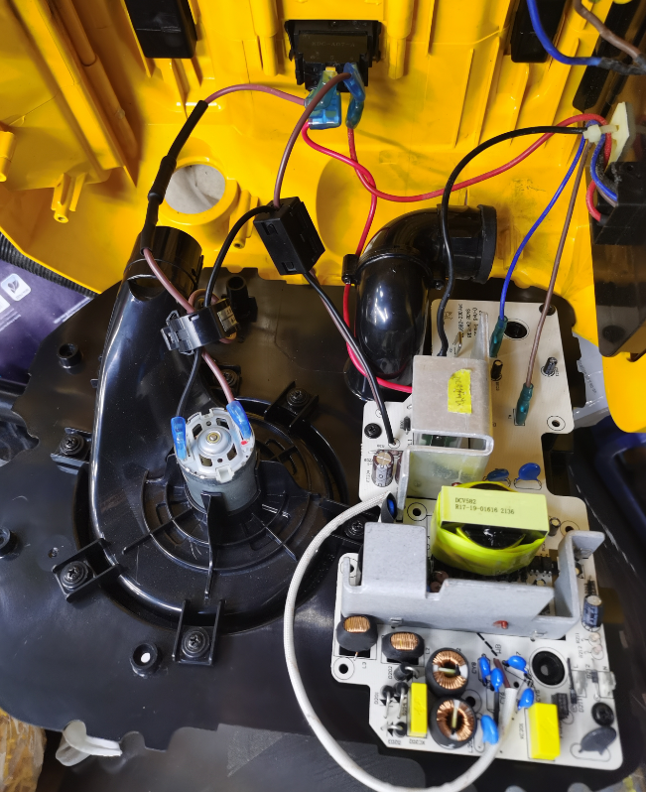
**Type1** Differences **Type2**
1、Switch
3、Wire
2、Magnetic Ring
4、Motor
5、PCBA

Slide 4
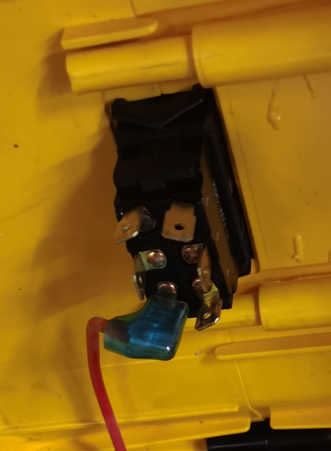
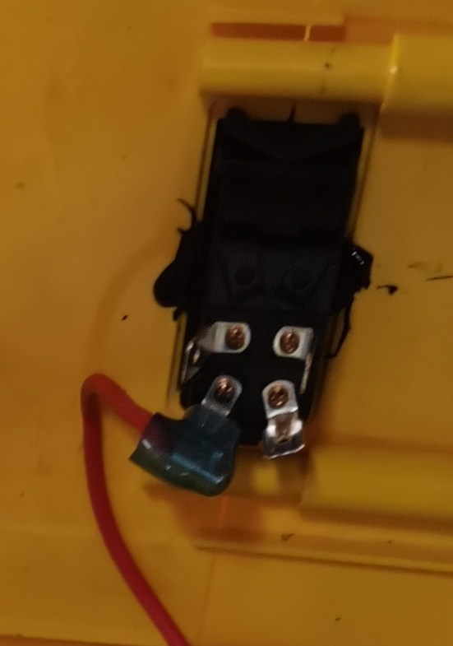
**Type1** DCV582/4 Switch **Type2**
*Switch – Actual part is different, but we still can use the original one to upgrade the machine.
*Type1 P/N: 11V6009-13E004
*Type2 P/N: 11V6073-14E003
Pin2
Pin1
Pin3
Pin5
Pin5
Pin3
Connection Diff:
SW_Pin1&Pin2 No Connect
SW_Pin3 Connect PCBA_B+ red wire
SW_Pin4 Connect Battery holder red wire
SW_Pin5 Connect PCBA_M+ Brown wire
SW_Pin6 Connect Motor_Red &Fuse wire
Pin6
Pin4
Pin6
Pin4

Slide 5
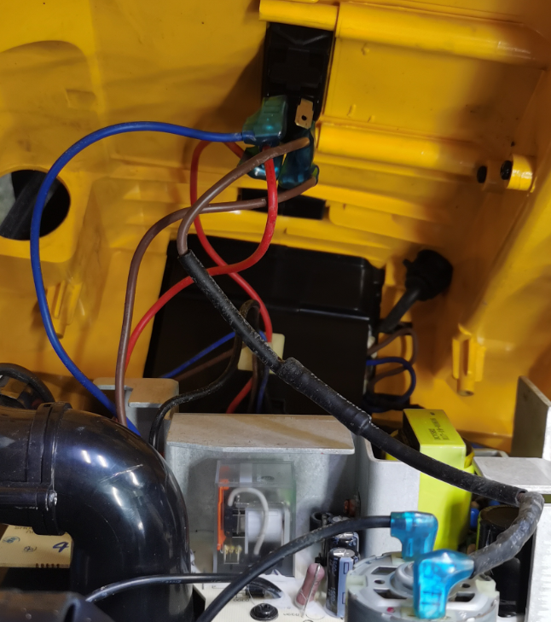
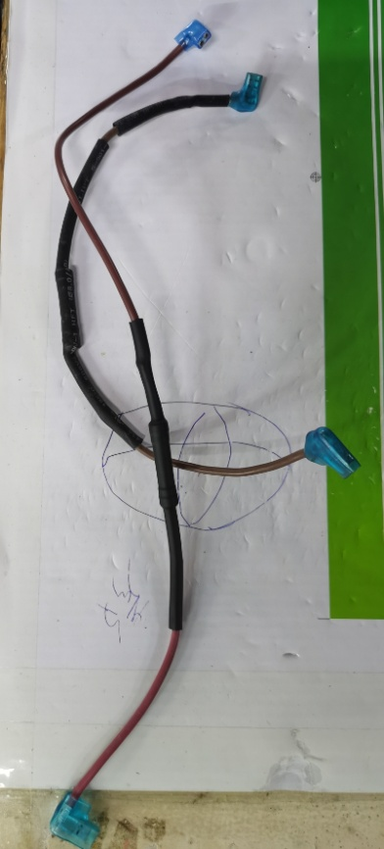
DCV582/4 Wires
*The connecting wires must be changed.
  1) The Switch blue wire cancel.
  2) The Fuse wire Type1:
  3) The Fuse wire Type2 :

Slide 6
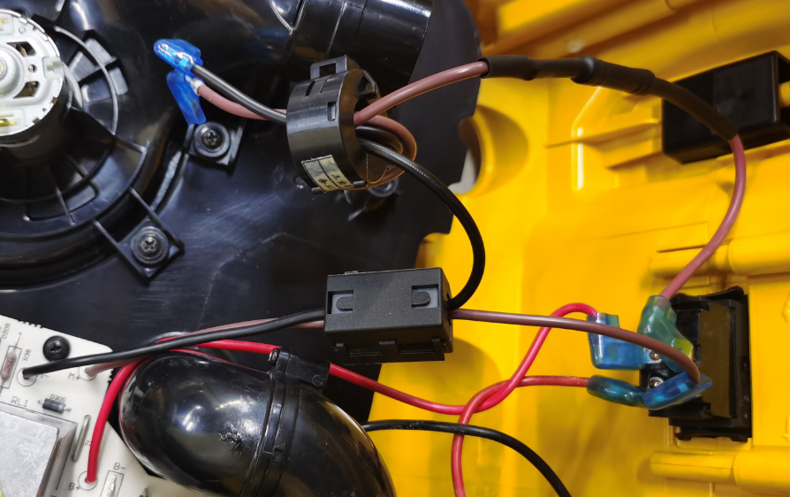
DCV582/4 Magnetic Ring
*The Magnetic must be Add.
*Type1 No Magnetic in line:
*Type2 Magnetic 2x:

Slide 7
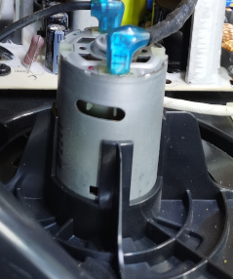
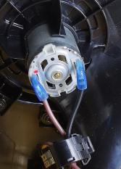
**Type1** DCV582/4 Motor **Type2**
*The motor must be changed.
*The motor Type1_12V P/N: 11V3436-13E005
*The motor Type2_18V P/N: 8DV-08000002-001
Note:
Motor + have red dots and connect brown wire

Slide 8
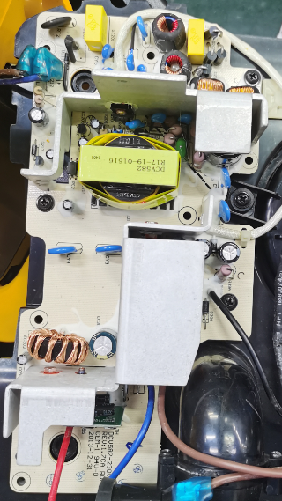
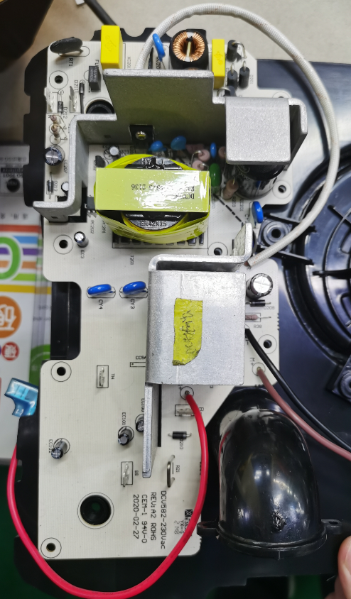
**Type1** DCV582/4 PCBA **Type2**
*The PCBA must be changed.
*The motor Type1_12V P/N: 11V3405-13E039
*The motor Type2_18V P/N: 805-01000003
Note: Type2 PCBA does not have blue wire

